Slide 1
3rd project details & figs

Slide 2
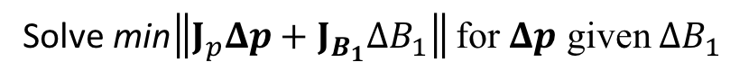
Progress to date
qMT optimization framework using qMRILab
Tissue & Protocol wrapper classes
Jacobian(Tissue, Protocol) class for pre-calc/caching Jacobian.
SPGR qMT Jacobian calculated using qMRILab’s steady-state qMT signal simulator
Optimization(Jacobian) class for optimizing qMT sequence
Evaluated improved B1 optimization metric
Tested by reproducing MRM simulations/sensitivity figure
Evaluated qMT parameter-error from above metric calc for uniform protocols /w varying:
# of offset points
# of FA_{MT}
Solve min$\left\|J_{p}Δp+J_{B_{1}}ΔB_{1}\right\|$ for $Δp$ given $ΔB_{1}$

Slide 3
Progress to date
Computed Jacobian for a full (312 pt) search-space qMT protocol
26 offsets (300 Hz to 20 kHz)
12 FA_{MT} vals (150:50:700)
Optimized qMT protocol using iterative procedure & CRLB
Optimizied qMT protocol for B1 insensitivity by:
Optimizing for deltaF_{B1} only
Alternating between for CRLB and deltaF_{B1} at every other iterations
Optimizing for CRLB but regularized by deltaF_{B1}
Found optimal lambda ~= 0.5
Preliminary no-noise simulations of errors in F due to B1 err = 5%
UK protocol -> deltaF ~ 1-2%
CRLB optimized -> deltaF ~ 0.5%
CRLB regularized by deltaF_{B1} -> deltaF ~ 0.09%

Slide 4
To-Do (must)
WM Monte-carlo simulations
3 different 10 pt protocols
2FA with log-uniform offsets
CRLB optimized (lambda = 0)
CRLB regularized by B1 (lambda 0.5, deltaF_{B1}^{VFA})
Generate 10,000 signal sets for each protocol, with rician noise added
50, 100, 200 SNR for M0? More?
Fit Data
For delta B1 = 0, 1, 5, 10, 25 %?
Analysis? (means and std of fitted params, stat tests between methods?)
To-Do (optional?)
Repeat Monte Carlo for other fixed tissues (e.g. GM & lesions)?
Repeat Monte Carlo for gaussian-distributed tissue values?
Repeat Monte Carlo for voxels with partial voluming?
Repeat protocol optimization & Monte Carlo simulations for other qMT methods?
Ramani, Yarnikh
Evaluate optimization for different regularization criteria?
e.g. T1 & B0, or B1 for kf?

Slide 5
Code overview

Slide 6
@TissueParams
@SeqProtocol
@SPGR_Tissue
@???_Tissue
e.g. Yarnykh
@SPGR_Protocol
@???_Protocol
e.g. Yarnykh
@SeqJacobian
@SPGR_Jacobian
@???_Jacobian
e.g. Yarnykh
@SeqOptimization
@IterativeOptimization
@???Optimization
e.g. SimulateAnnealsing

Slide 7
@TissueParams
Public Properties | Public Methods
None | save(obj, fileName) load(obj, fileName) paramsArray = getParams(tissueKeys) paramValue = getParameter(paramKey)
@SPGR_Tissue
Public Properties | Public Methods
paramsKeys = {'F', 'kf', 'R1f', 'R1r', 'T2f', 'T2r'} fitParamsKeys = {'F', 'kf', 'R1f', 'T2f', 'T2r'} | SPGR_Tissue(paramsValues) paramsValues: Array of values for paramsKeys

Slide 8
@SeqProtocol
Public Properties | Public Methods
None | save(obj, fileName) load(obj, fileName) prot = getProtocol() **Abstract** totalNumOfMeas = getNumberOfMeas() paramValue = getParameter(protKey) remove(indices)
@SPGR_Protocol
Public Properties | Public Methods
fitProtKeys = {'B1_IR', 'B1_VFA'} B1_value = 1.0 | SPGR_Protocol(fileName) fileName: qMRLab saved protocol *.mat string totalNumOfMeas = getNumberOfMeas() paramValue = getParameter(protKey) remove(indices)

Slide 9
@SeqJacobian
Public Properties | Public Methods
None | SeqJacobian(@SeqProtocol, @TissueParams) jacobianMatrix = getJacobian() *jacobianStruct = getJacobianStruct() computeOpts = compute(computeOpts) computOpts: Struct with the following properties: mode: 'New', 'Resume', or 'Completed' paramsOfInterest: Cell array of strings of fitParamsKeys to calculate Jacobian. lineBuffer:
*jacobianStruct properties:
jacobianMatrix
paramsKeys
paramsVals
protocol
status
completedLines
signal
d_signal
@SPGR_Protocol
Public Properties | Public Methods
None | SPGR_Jacobian(@SPGR_Protocol, @SPGR_Tissue)

Slide 10
@SeqOptimization
Public Properties | Public Methods
None | *Static* paramError = minimizeParamErrorBecauseOfMeasError(paramJacMat, measJacMat, measError) fisherInformationMatrix = calcFIM(jacobianMatrix) crlb = calcCRLB(jacobianMatrix)
@IterativeOptimization
Public Properties | Public Methods
metricSet = {'CRLB'}; | IterativeOptimization(@SeqJacobian, opts) opts: Struct with the following properties: fitParams: Cell array of strings of fitParamsKeys to include in optimization (cols of Jac.) (optional) b1Params: Cell string of B1 params name for B1-sensitivity optimization) computeSingle(metricFlag) computeDoubleAlternate(metricFlags) computeRegularized(metricFlags, regularizationCoeff) rankedAcqPoints = getRankedAcqPoints() metricValsAcqPoints = getMetricValsAcqPoints() reguTermValsAcqPoints = getReguTermValsAcqPoints() [rankedAcqPoints_sorted, metricValsAcqPoints_sorted] = getSorted() [rankedAcqPoints_sorted, reguTermValsAcqPoints_sorted] = getSortedRegTerm() [rankedAcqPoints_sorted, protocol_sorted] = getSortedProtocol()

Slide 11
Theory Overview

Slide 12
MRM Paper theory

Slide 13
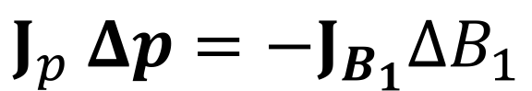
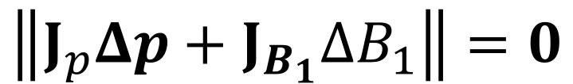
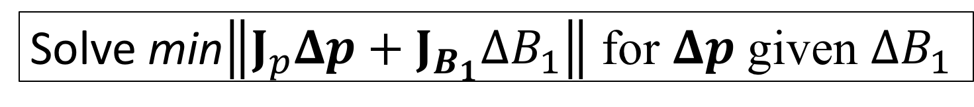
Updated approach
$$J_{p} Δp=−J_{B_{1}}ΔB_{1}$$
$$\left\|J_{p}Δp+J_{B_{1}}ΔB_{1}\right\|=0$$
Solve min$\left\|J_{p}Δp+J_{B_{1}}ΔB_{1}\right\|$ for $Δp$ given $ΔB_{1}$

Slide 14
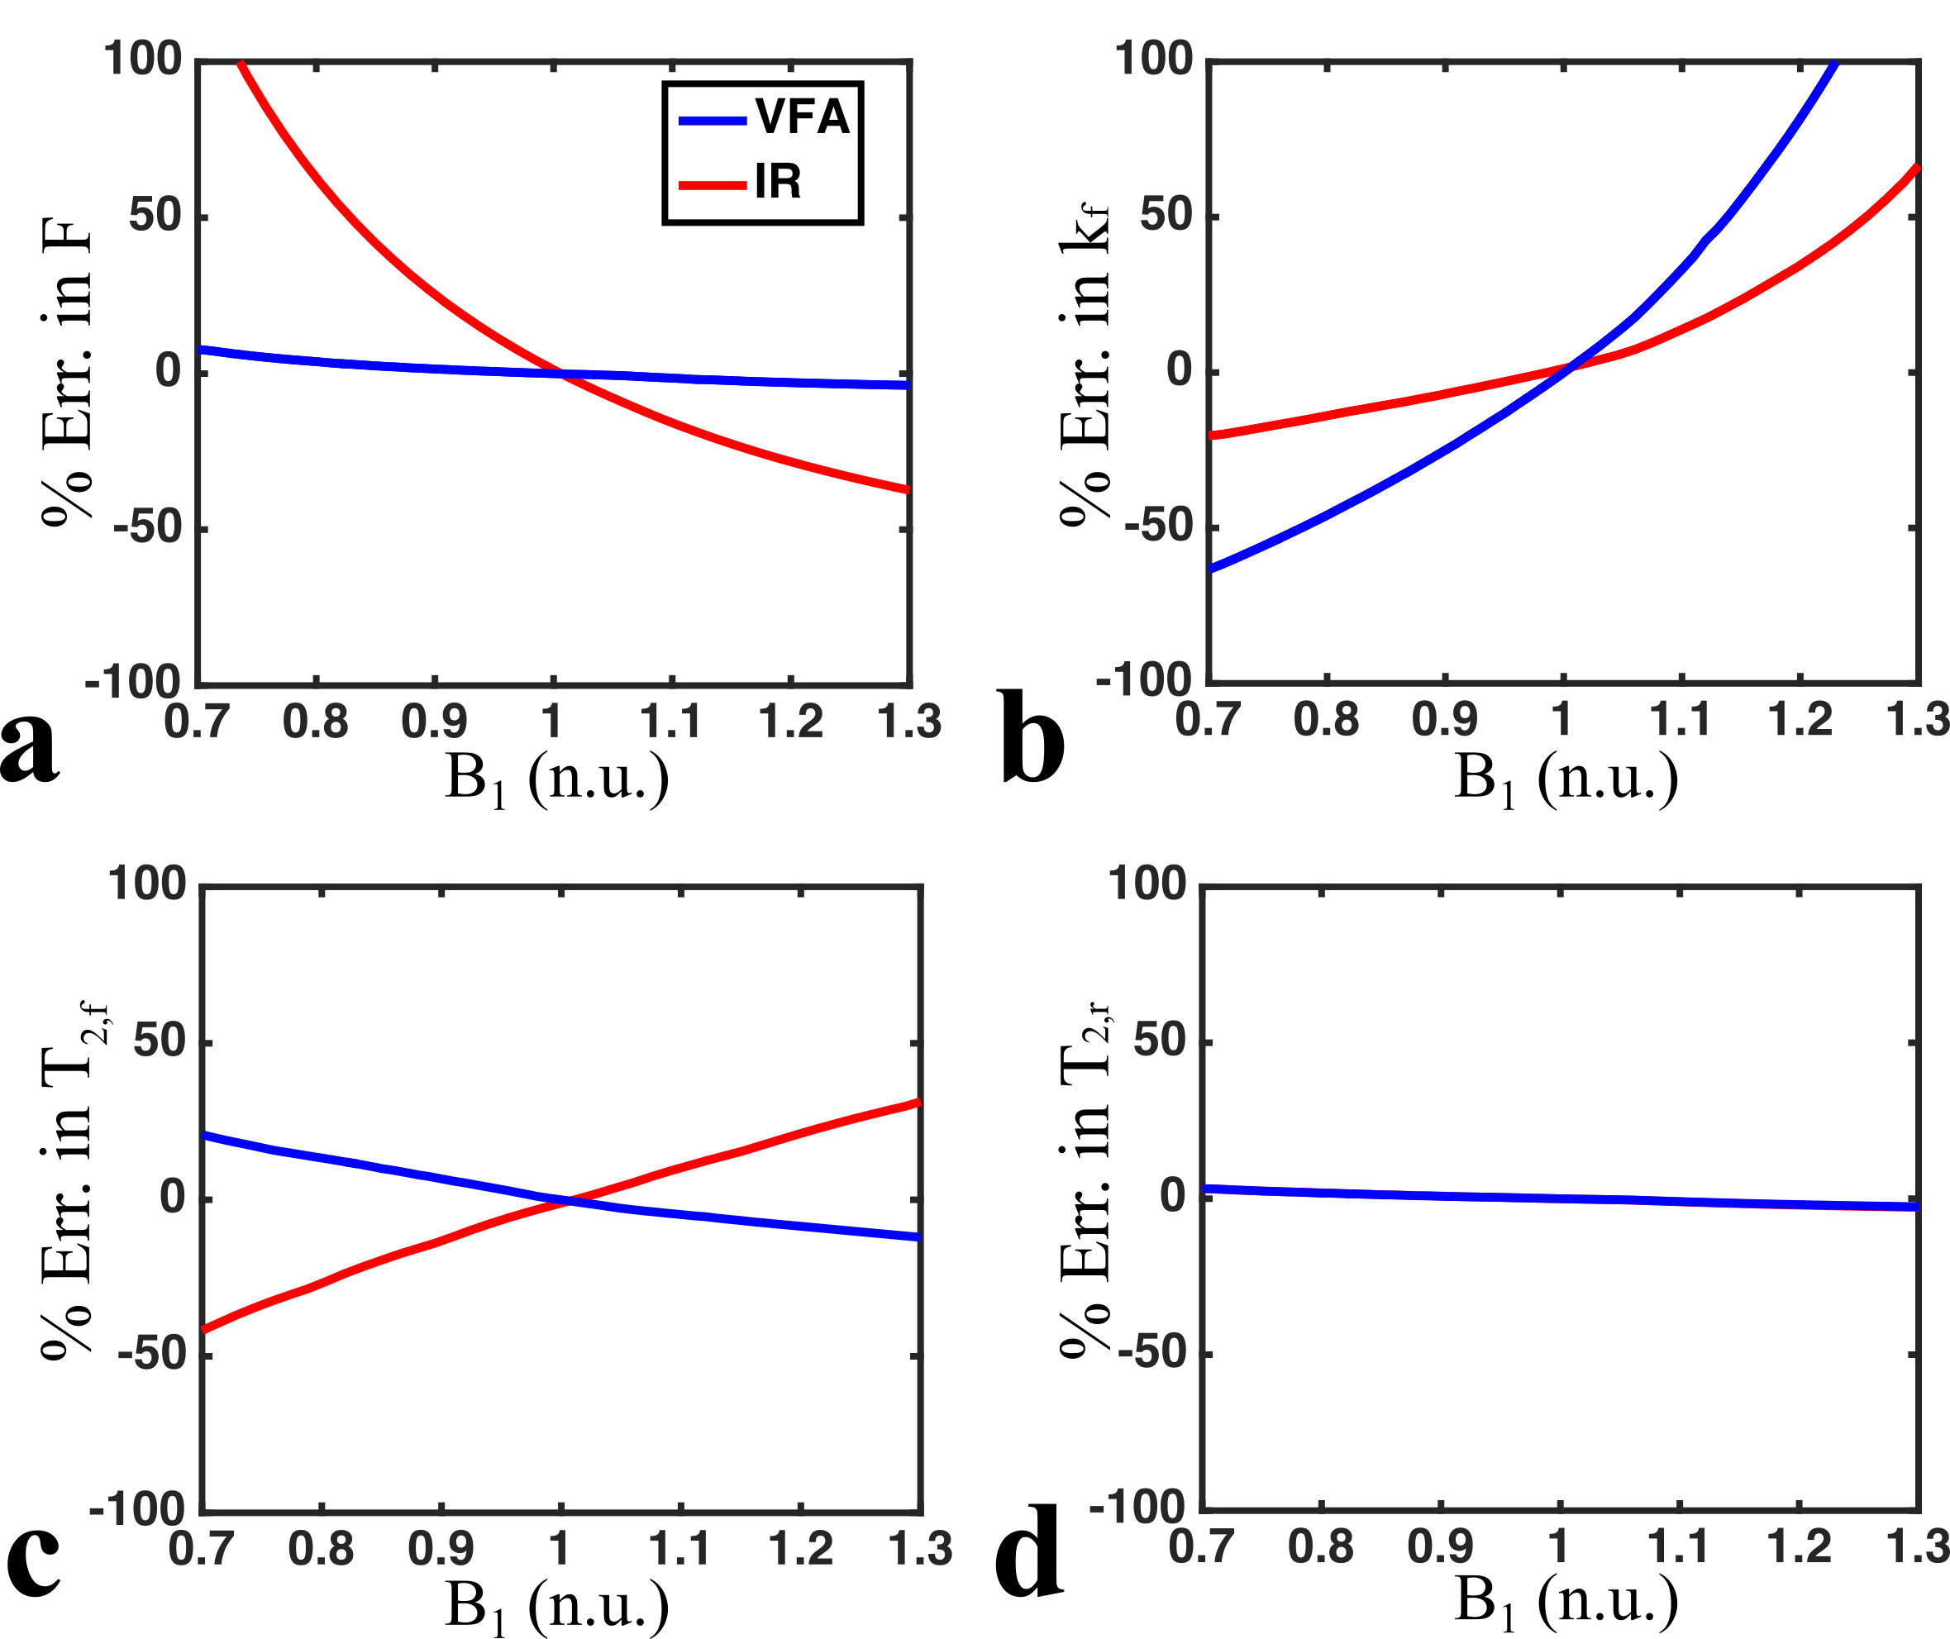
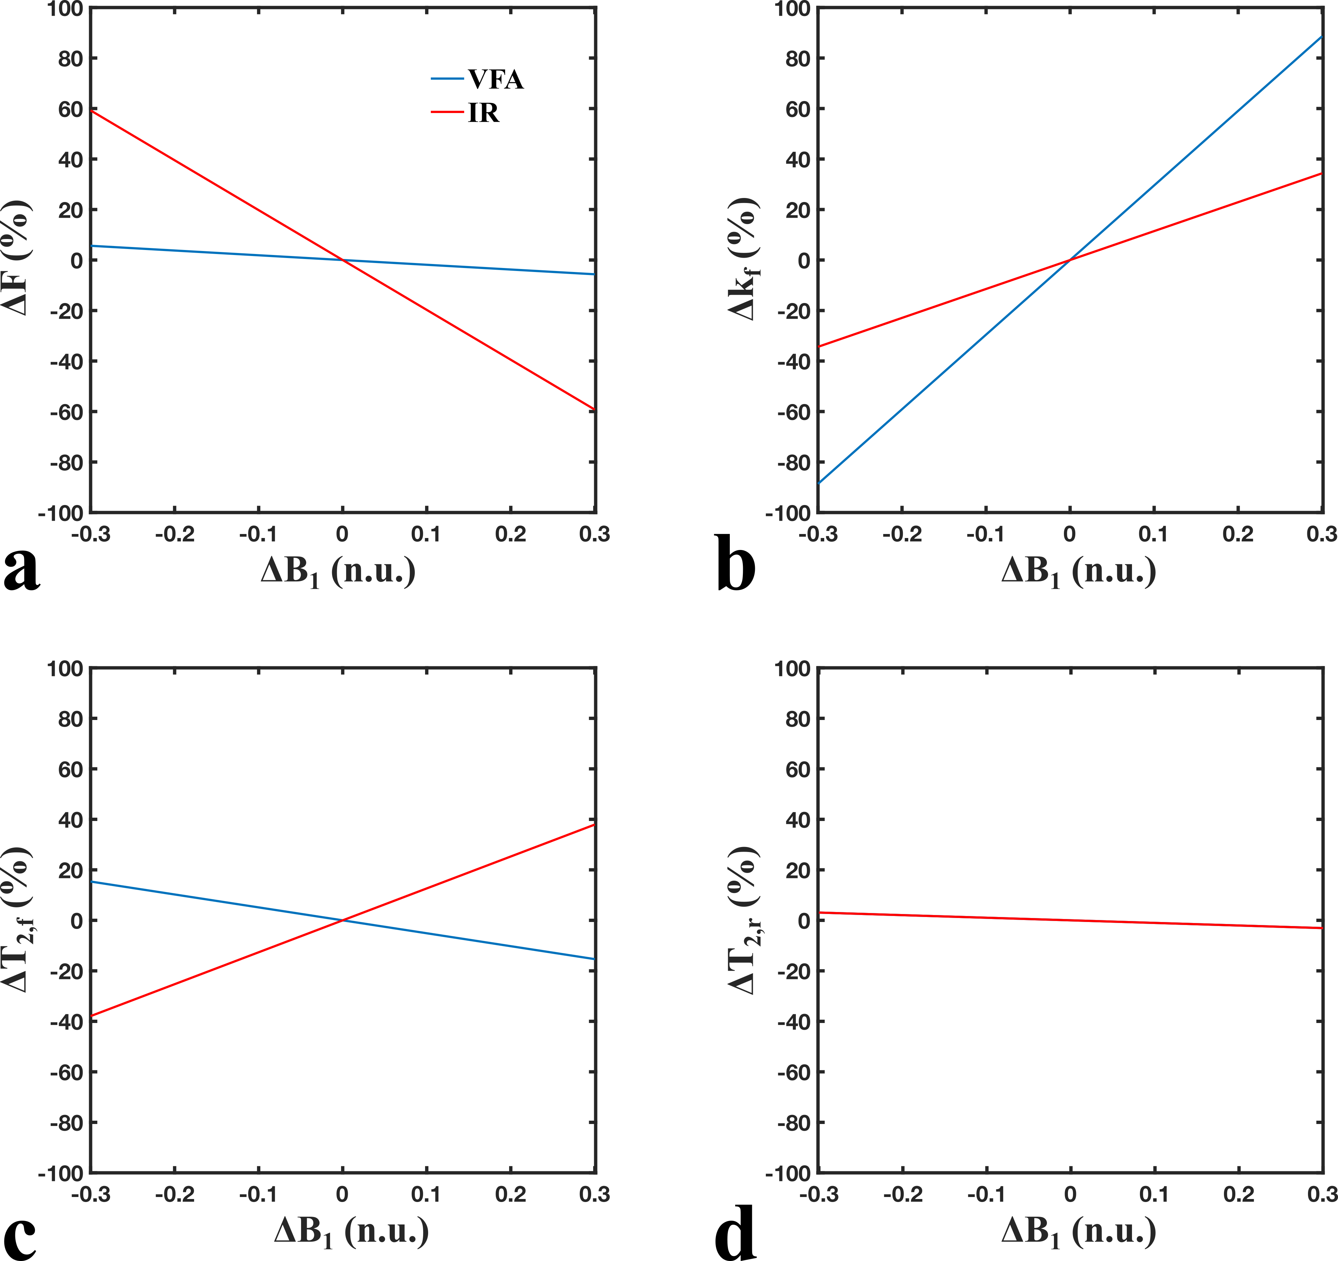
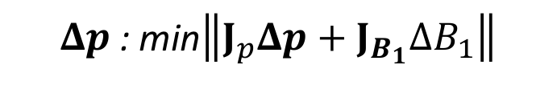
Parameter fitting error in simulations
$Δp$: min$\left\|J_{p}Δp+J_{B_{1}}ΔB_{1}\right\|$
MRM Paper
Current Work

Slide 15
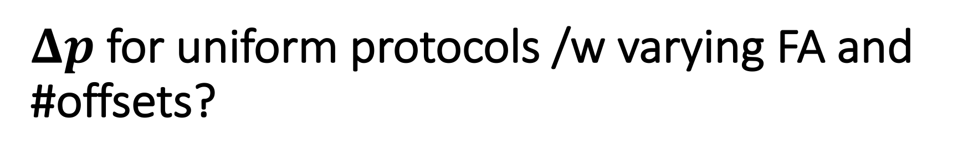
$Δp$ for uniform protocols /w varying FA and #offsets?

Slide 16
WM tissue parameter values
F = 0.15 n.u.
k_{f} = 4.0 s⁻¹
T_{1,f} = 900 ms
R_{1,r} = 1 s
T_{2,f} = 30 ms
T_{2,r} = 12 𝝁s

Slide 17
Protocol definitions
Single FA
150
400
650
2FA
(150, 400)
(150, 650)
(400, 650)
3FA
(150, 400, 650)
Offset values
[300 Hz, 20 kHz]
uniform-logarithmically spaced
Total # of points ranging from 8 to 30
Single FA, 8:2:30 offsets
2FA, 4:1:15 offsets
3FA, 3:1:10 FA

Slide 18
Protocol pre-procesing
Calculate higher « protocol resolution » Sf cache, then set-up each protocol using that Sf cache.
Some protocol points (<5%) produced erroneous/outlier (non-continuous) Jacobian element values
Wonky/sensitive steady-state signal convergence?
Identified all such point in the higher « protocol resolution » set, and if an outlier point was present in a studied protocol, change it to the nearest neighbour from high res.

Slide 19
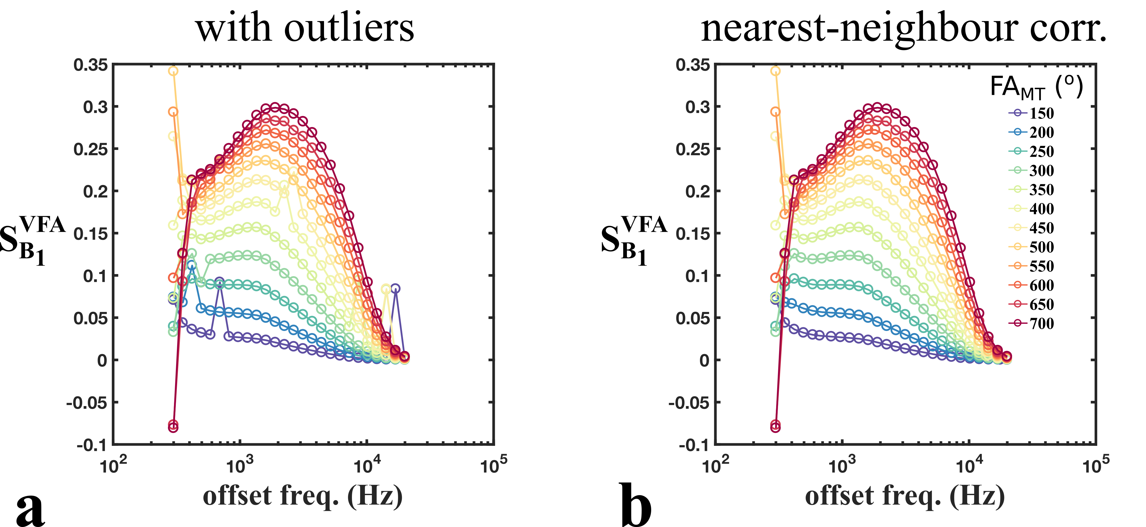

Slide 20
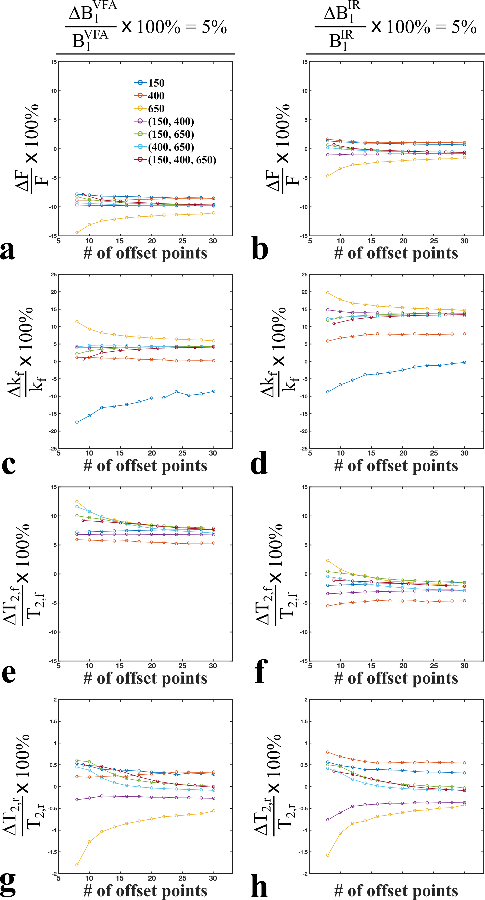

Slide 22
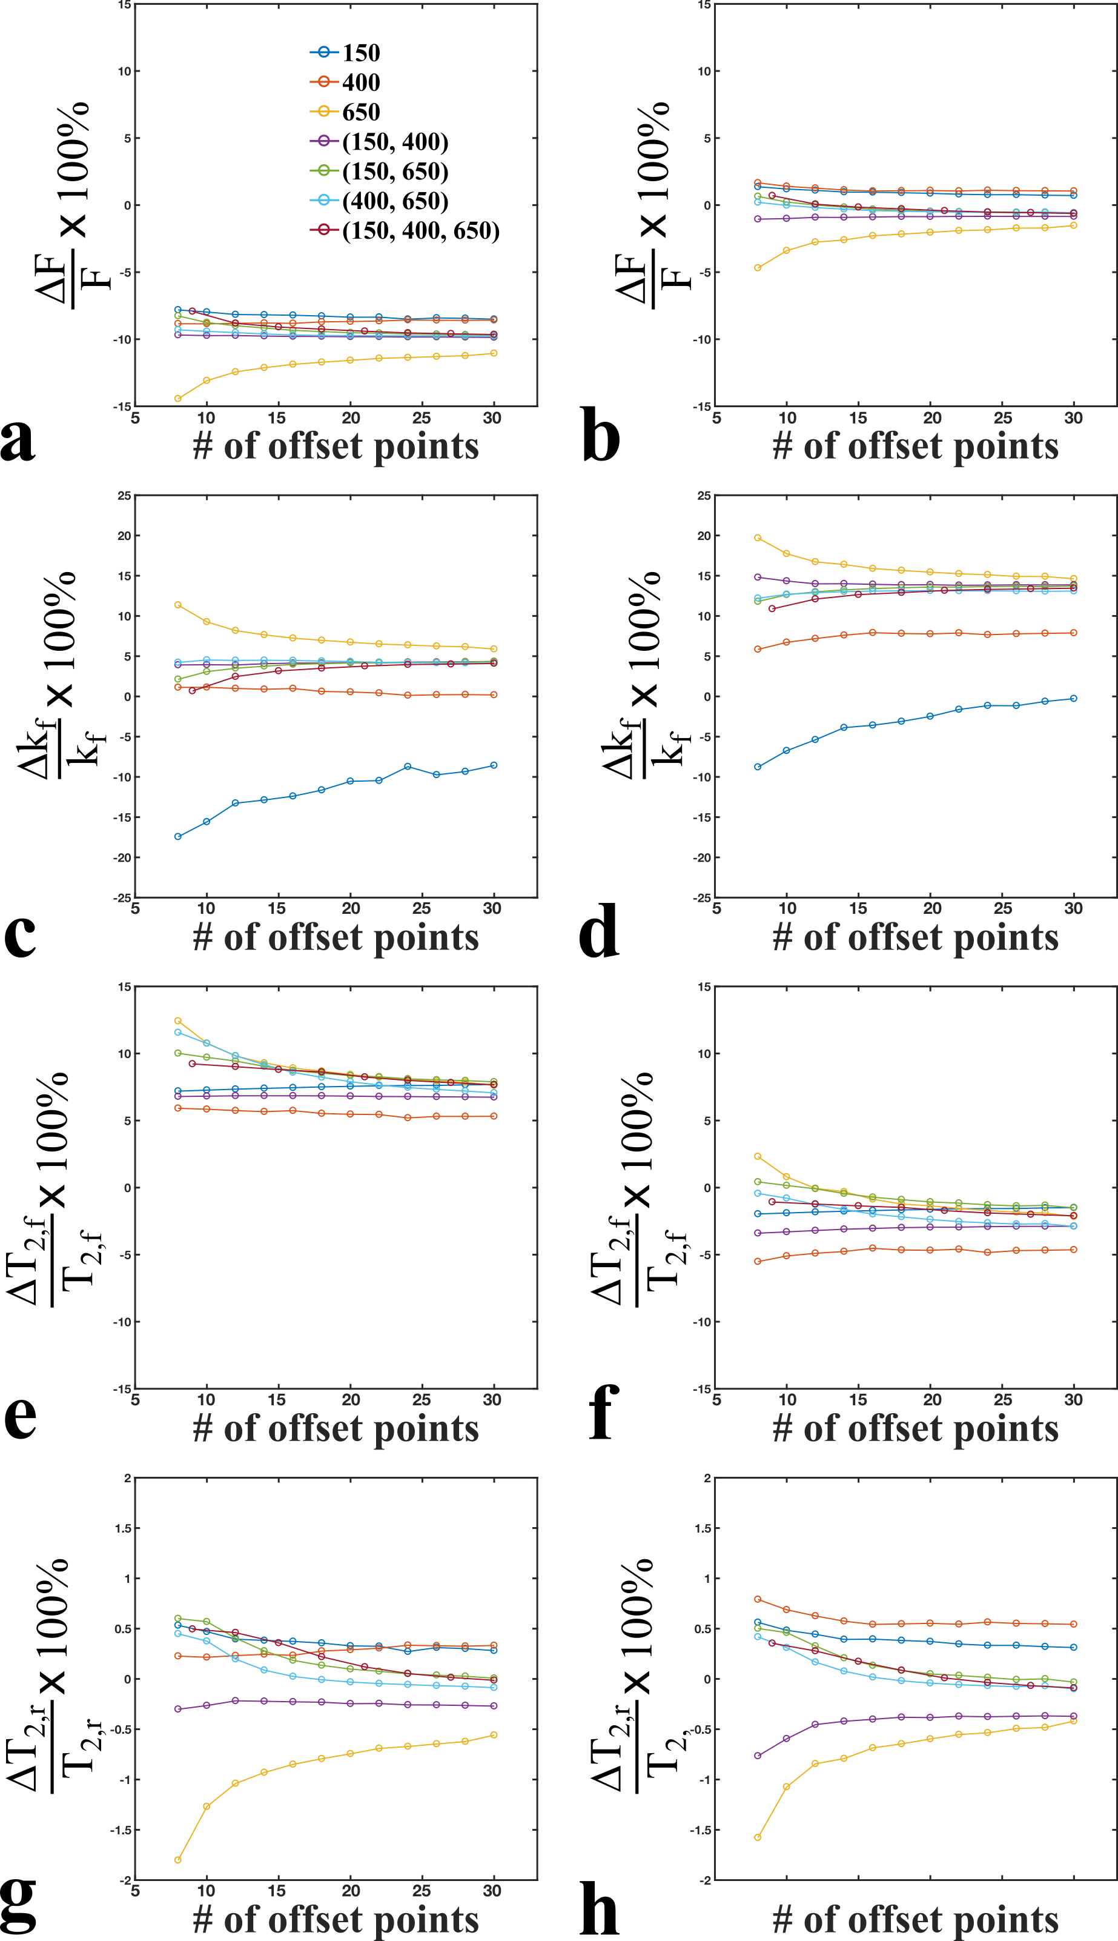

Slide 25
Data visualization ideas
instead?

Slide 26
Jacobian/Sensitivity plots
Pre-calculated/cached the Jacobian for the following protocol:
TR = 25 ms
12 FA_{MT} (150:50:700 deg)
26 offsets (300 Hz to 20 kHz)

Slide 27
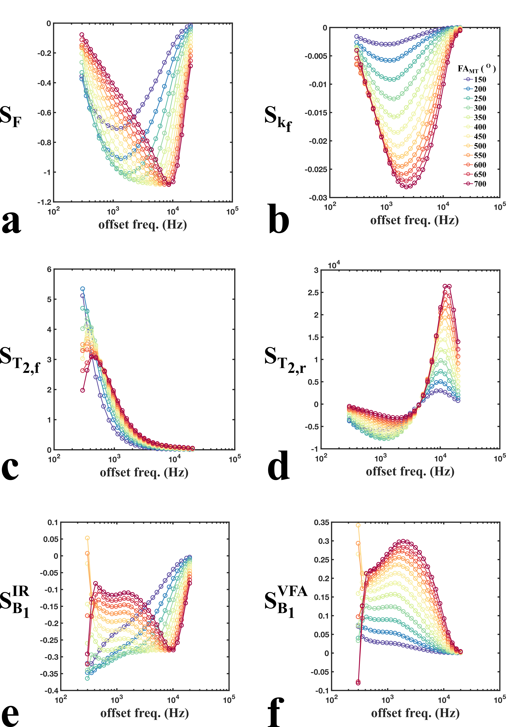

Slide 31
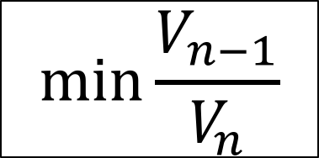
Iterative CRLB Optimization
Cercignani’s Fisher Information/Cramer-Rao Lower Bound equations
$$\min{\frac{V_{n−1}}{V_{n}}}$$
, considering all n-1 protocol combinations

Slide 32
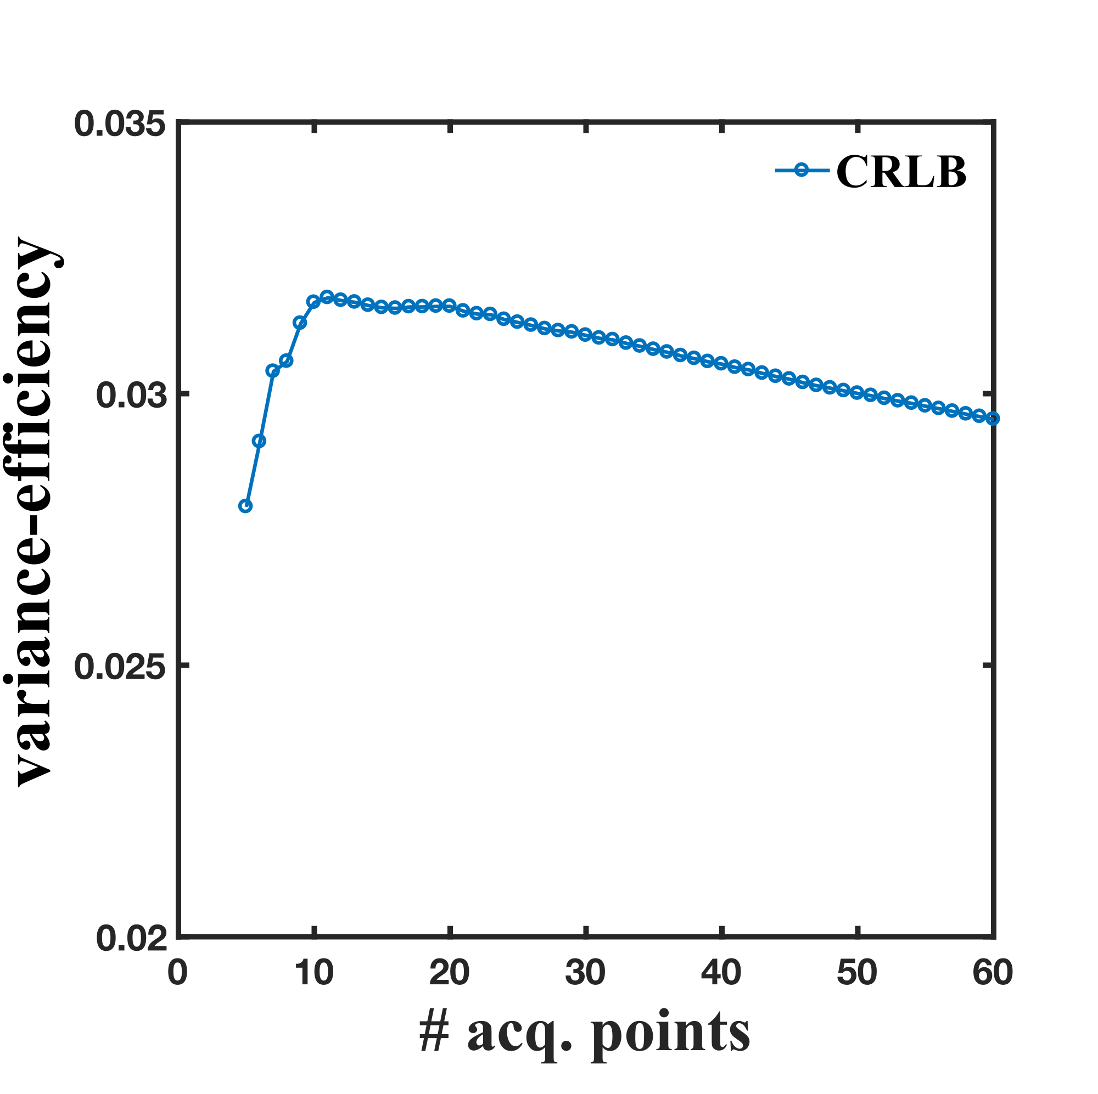
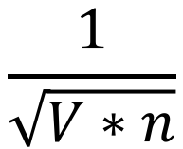
Iterative CRLB Optimization; comparison with Ives
$$\frac{1}{\sqrt{V∗n}}$$
* variance-efficiency =

Slide 33
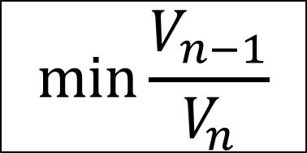
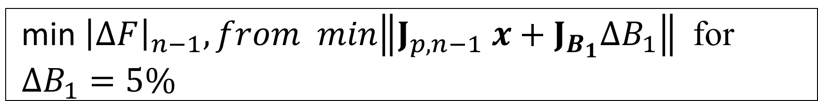
Single Optimization
$$\min{\frac{V_{n−1}}{V_{n}}}$$
vs
min ${\left|ΔF\right|}_{n−1}, from min\left\|J_{p,n−1} x+J_{B_{1}}ΔB_{1}\right\|$ for $ΔB_{1}=5\%$

Slide 34
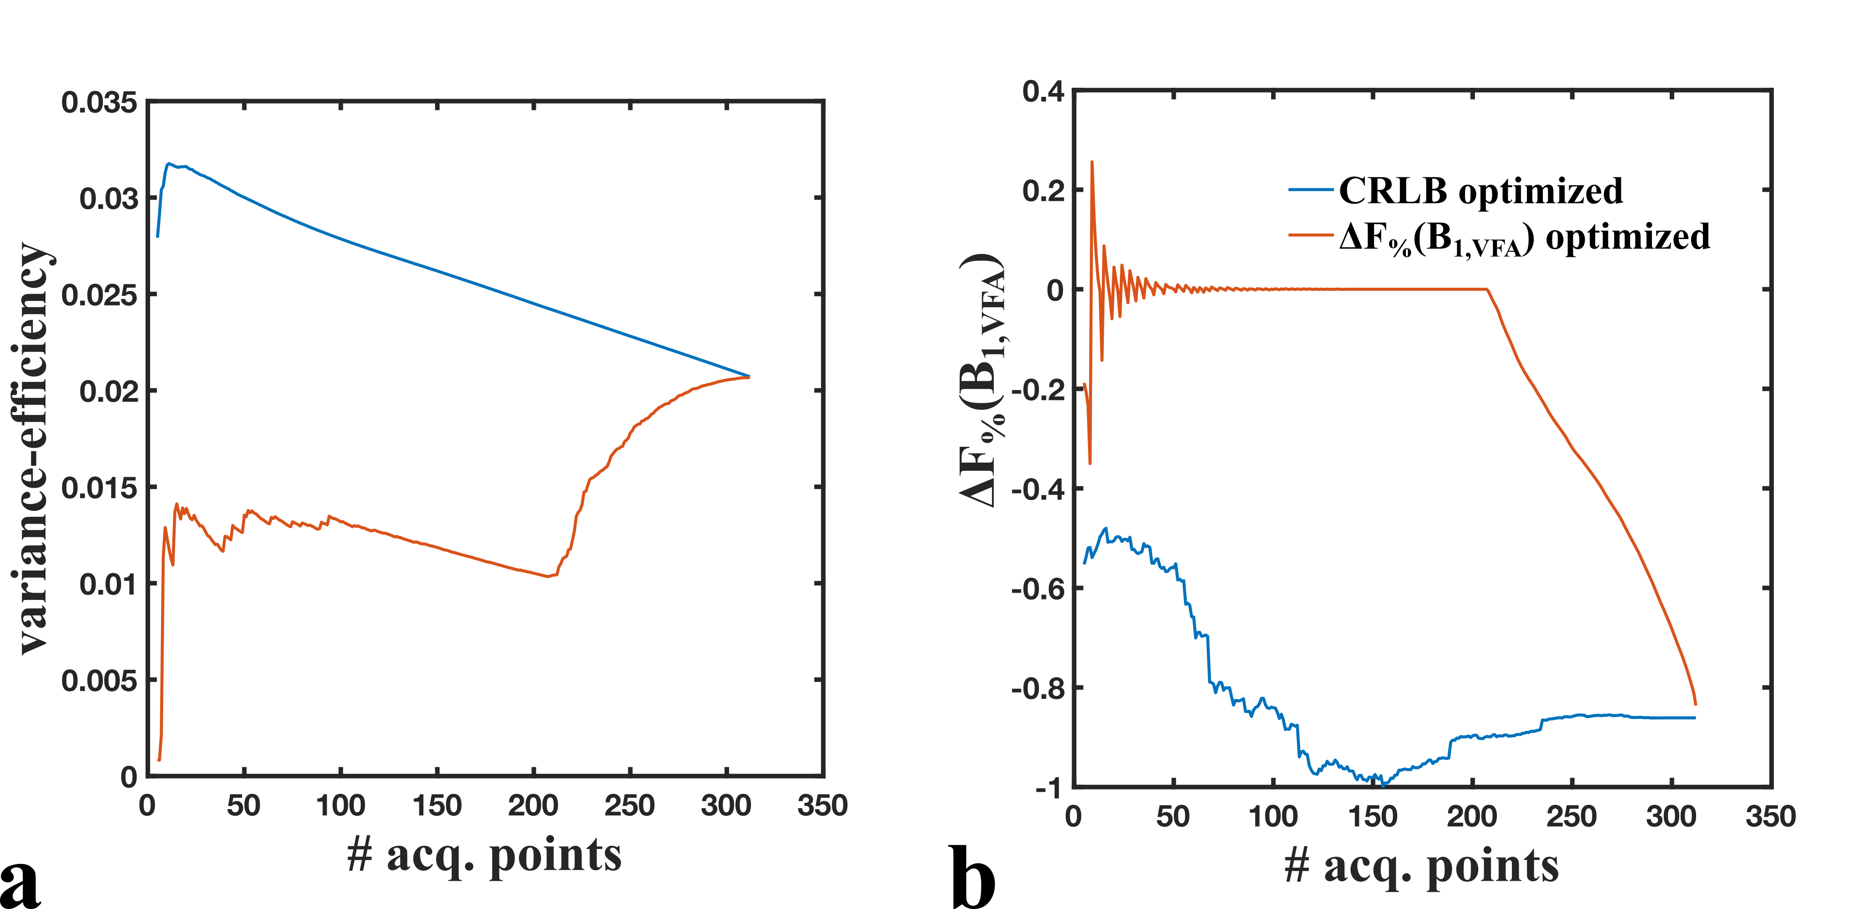

Slide 35
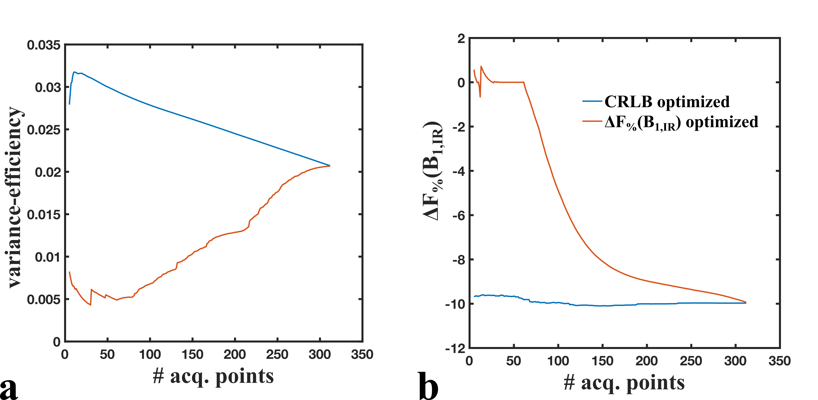

Slide 36
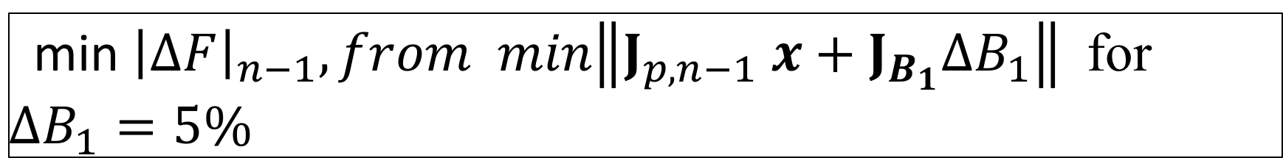
Single Optimization
$$\min{\frac{V_{n−1}}{V_{n}}}$$
vs
min ${\left|ΔF\right|}_{n−1}, from min\left\|J_{p,n−1} x+J_{B_{1}}ΔB_{1}\right\|$ for $ΔB_{1}=5\%$

Slide 37
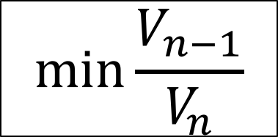
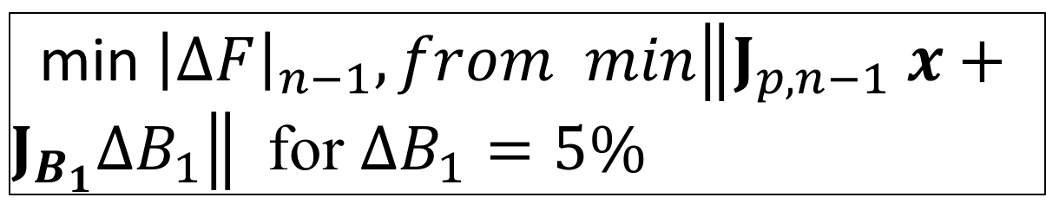
Alternating Optimization
$$\min{\frac{V_{n−1}}{V_{n}}}$$
odd n-1
min ${\left|ΔF\right|}_{n−1}, from min\left\|J_{p,n−1} x+J_{B_{1}}ΔB_{1}\right\|$ for $ΔB_{1}=5\%$
even n-1

Slide 38
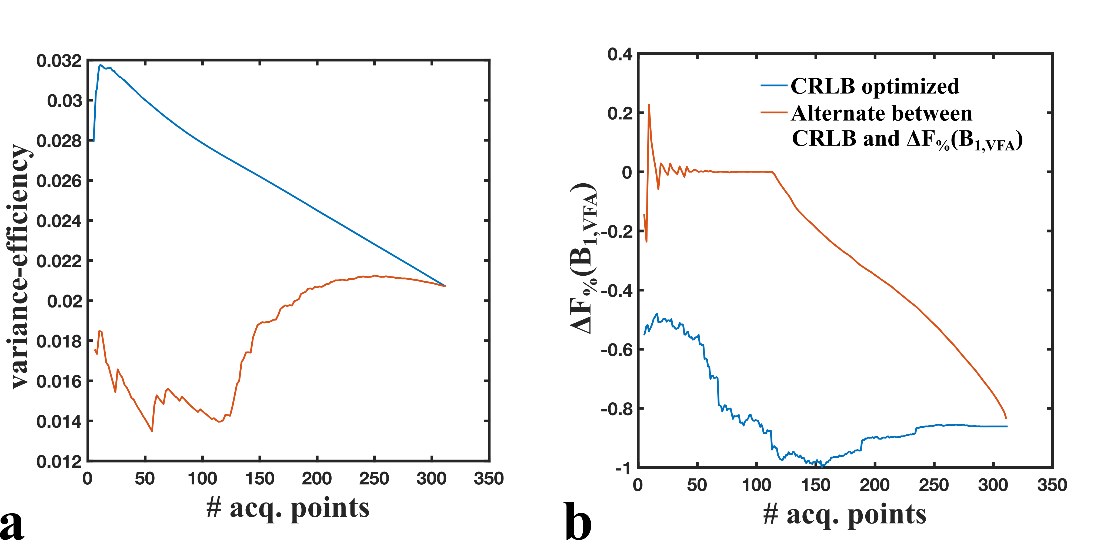

Slide 39
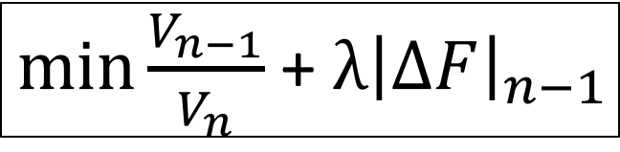
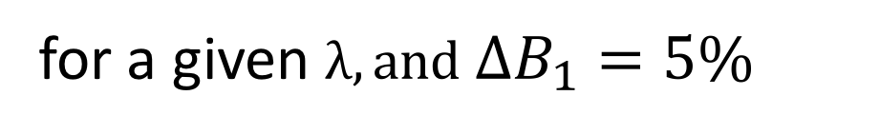
Regularized Optimization
$\min{\frac{V_{n−1}}{V_{n}}}$ + $λ{\left|ΔF\right|}_{n−1}$
for a given $λ,and ΔB_{1}=5\%$

Slide 40
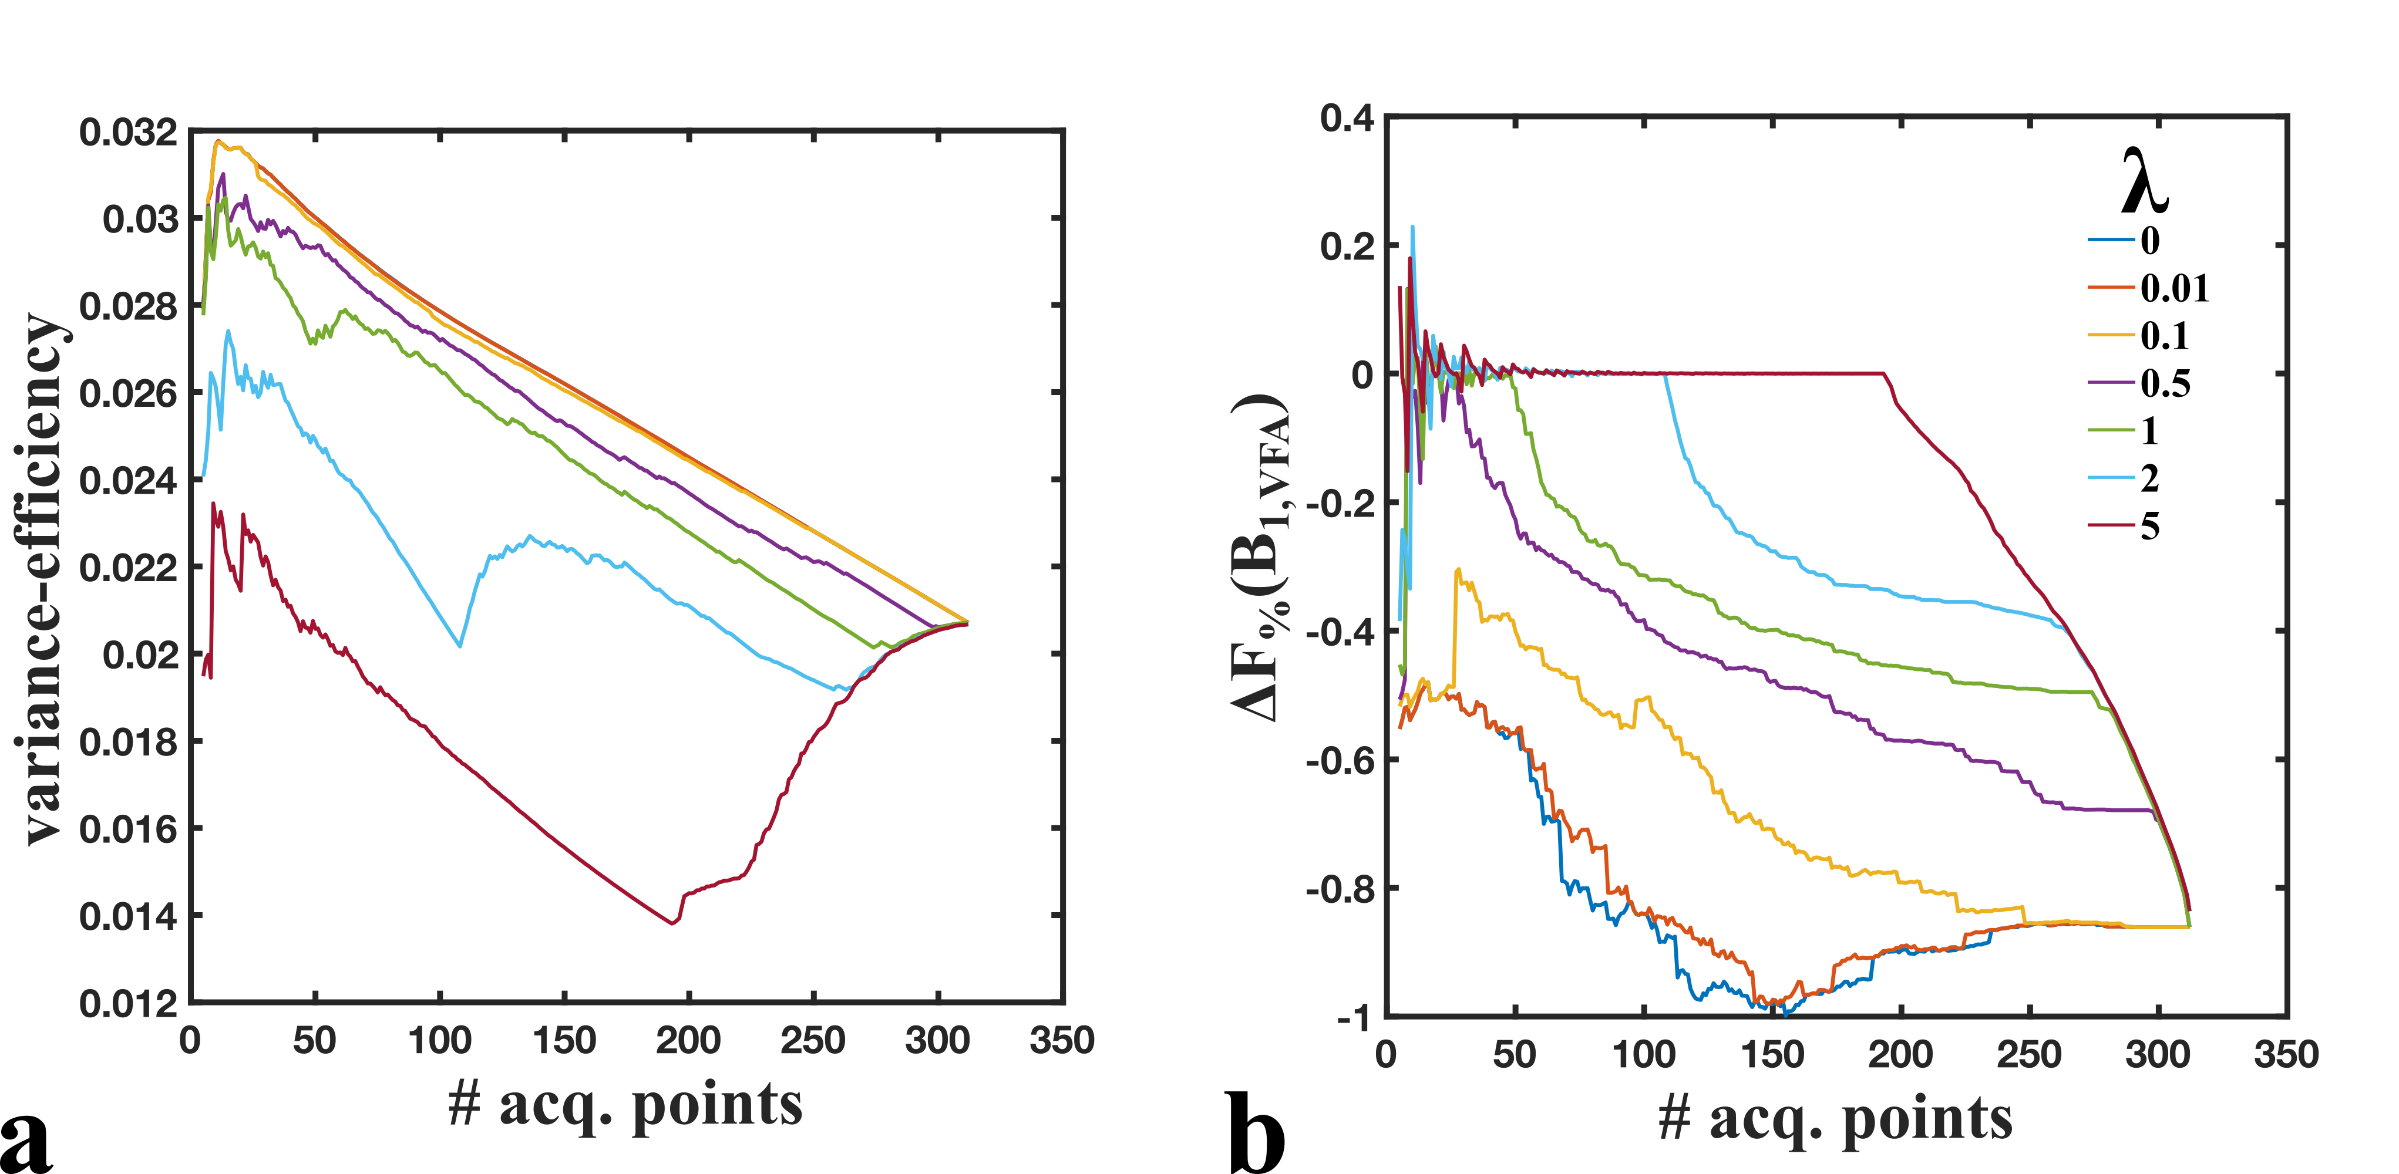

Slide 41
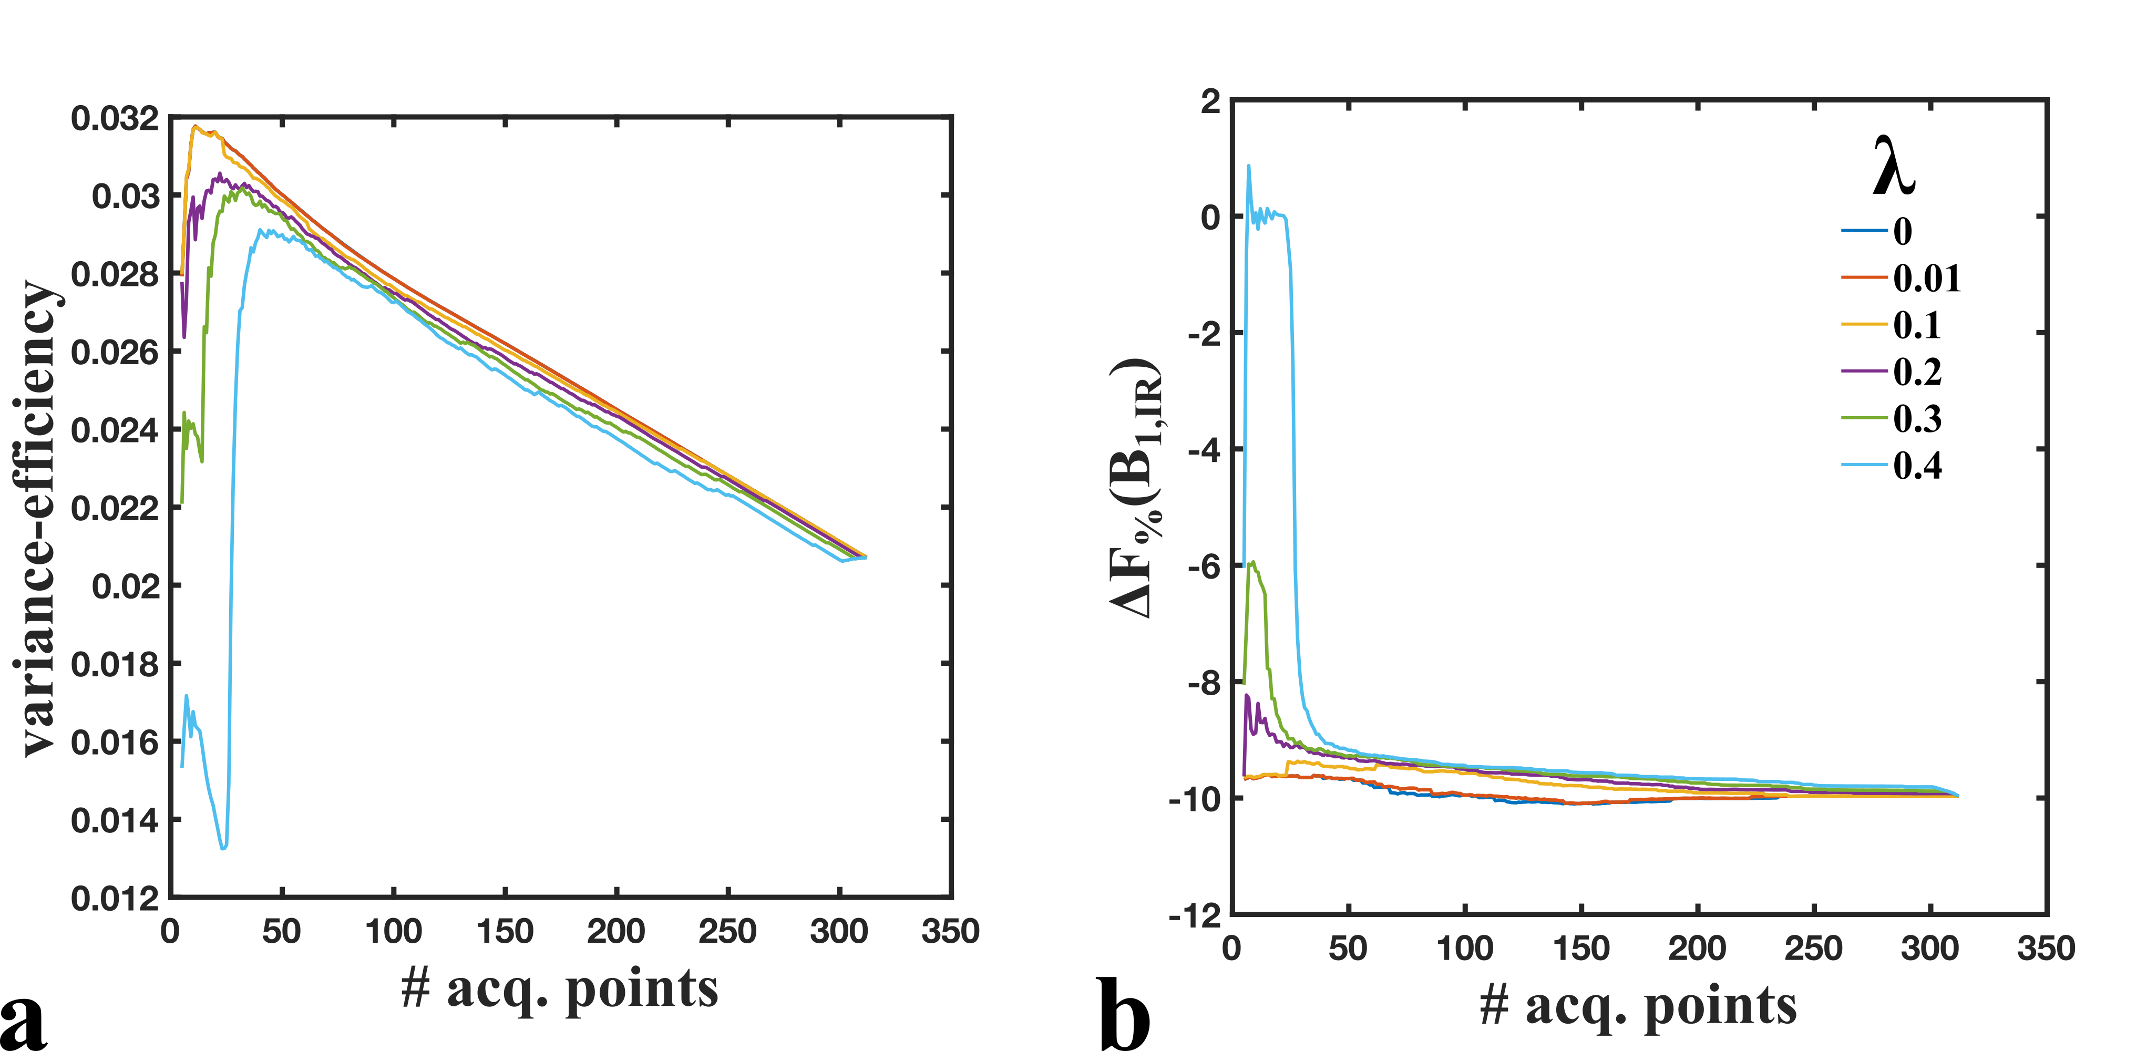

Slide 42
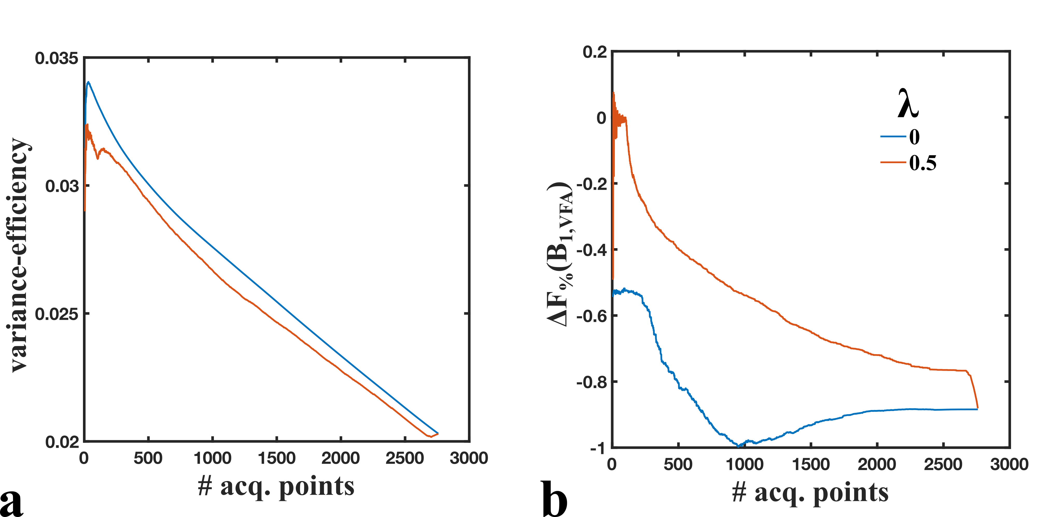
~2900 pt protocol

Slide 43
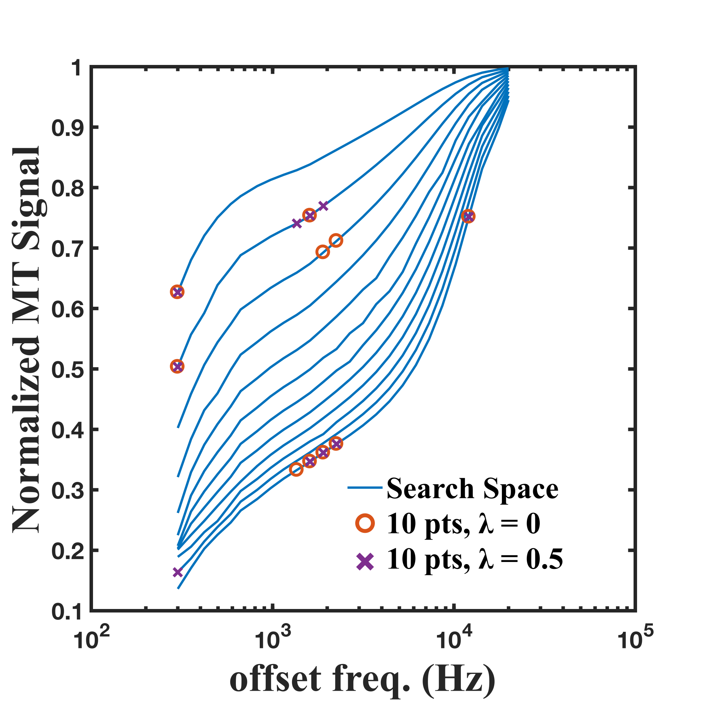
~300 pt protocol

Slide 44
No-noise fitting simulations
(sidenote, using previous MRM paper’s tissue values (e.g. F = 0.122) and 10 point uniform protocol
5% error in B1 lead to 1.86% error in fitted F, assuming VFA T1

Slide 45
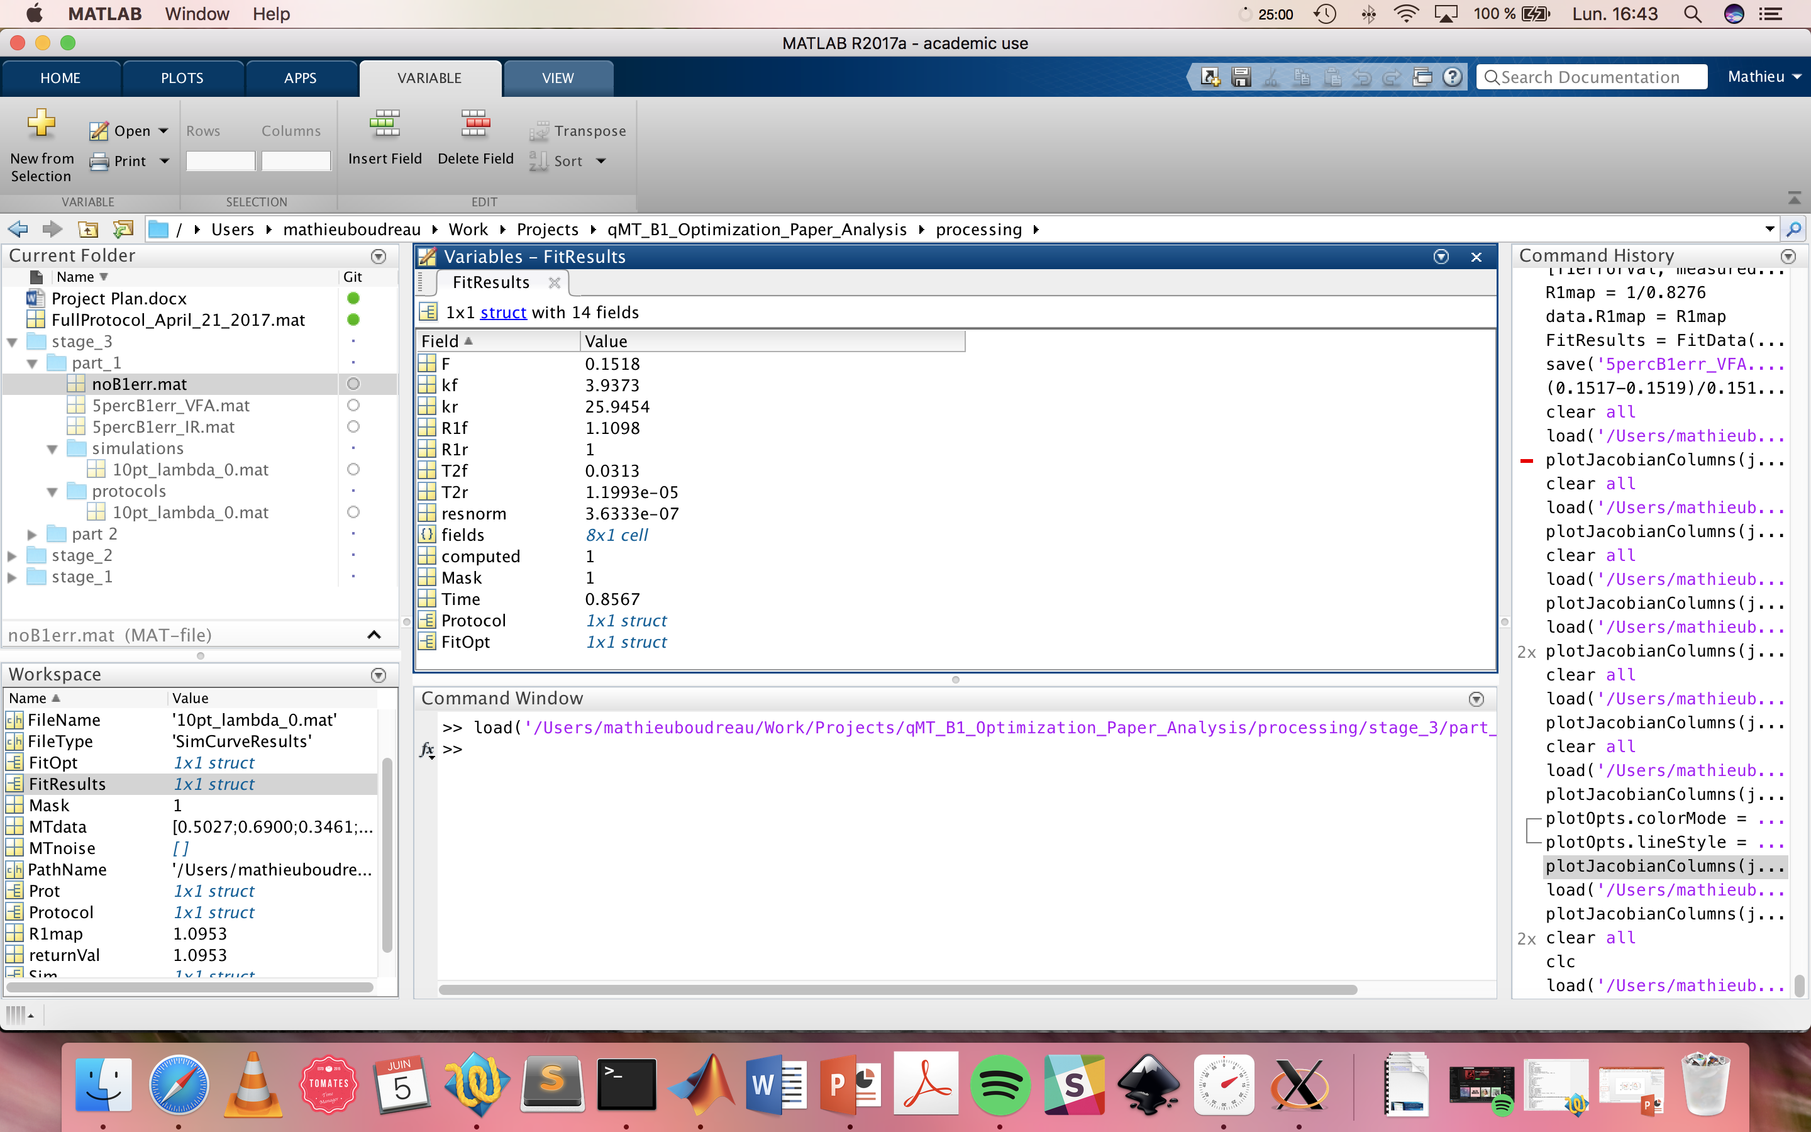
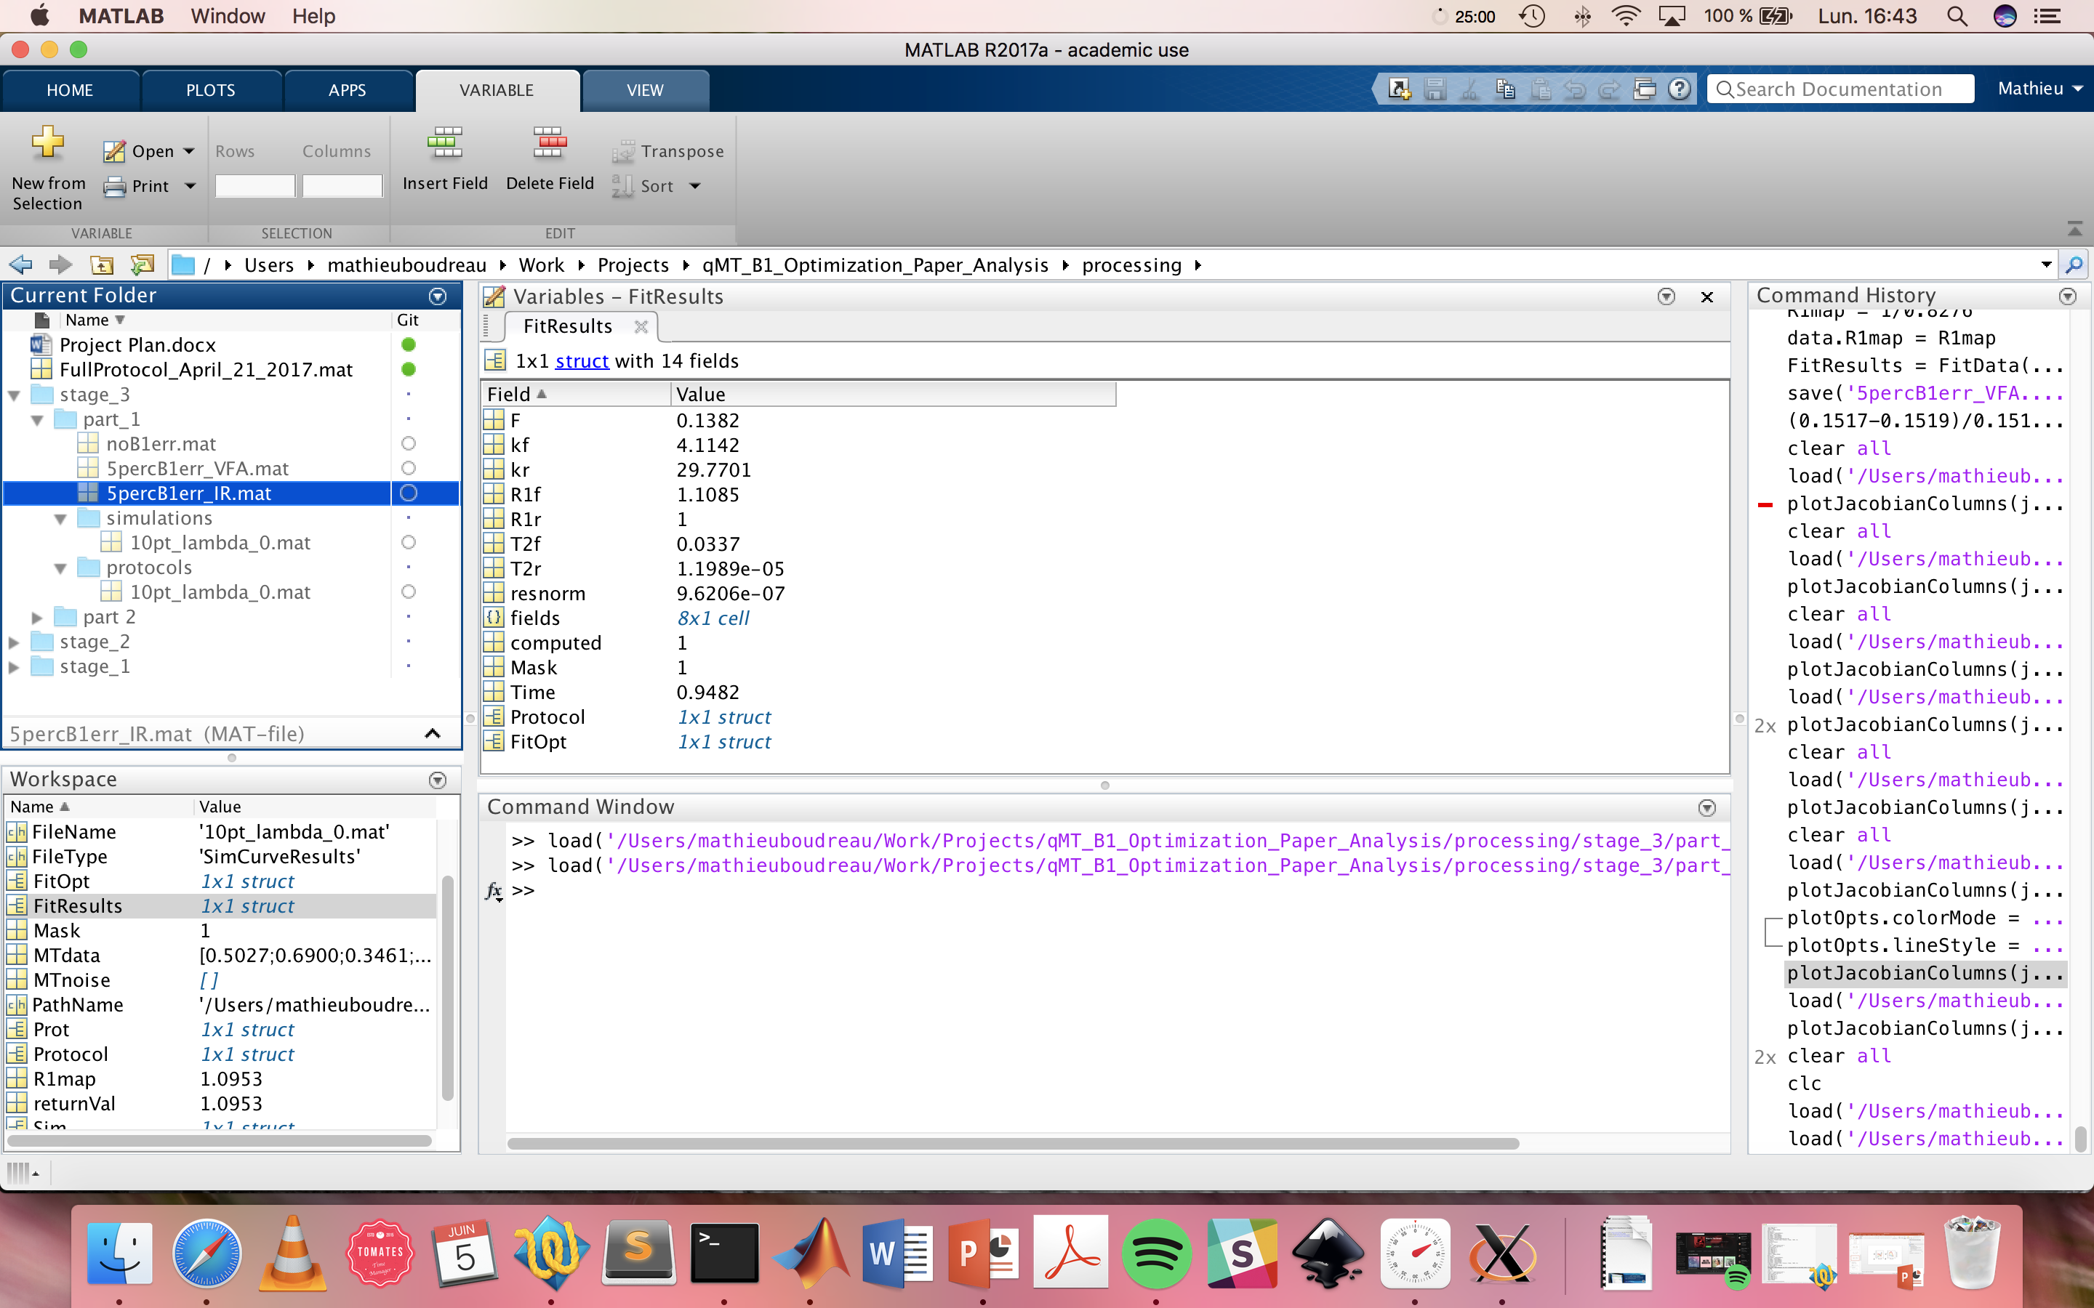
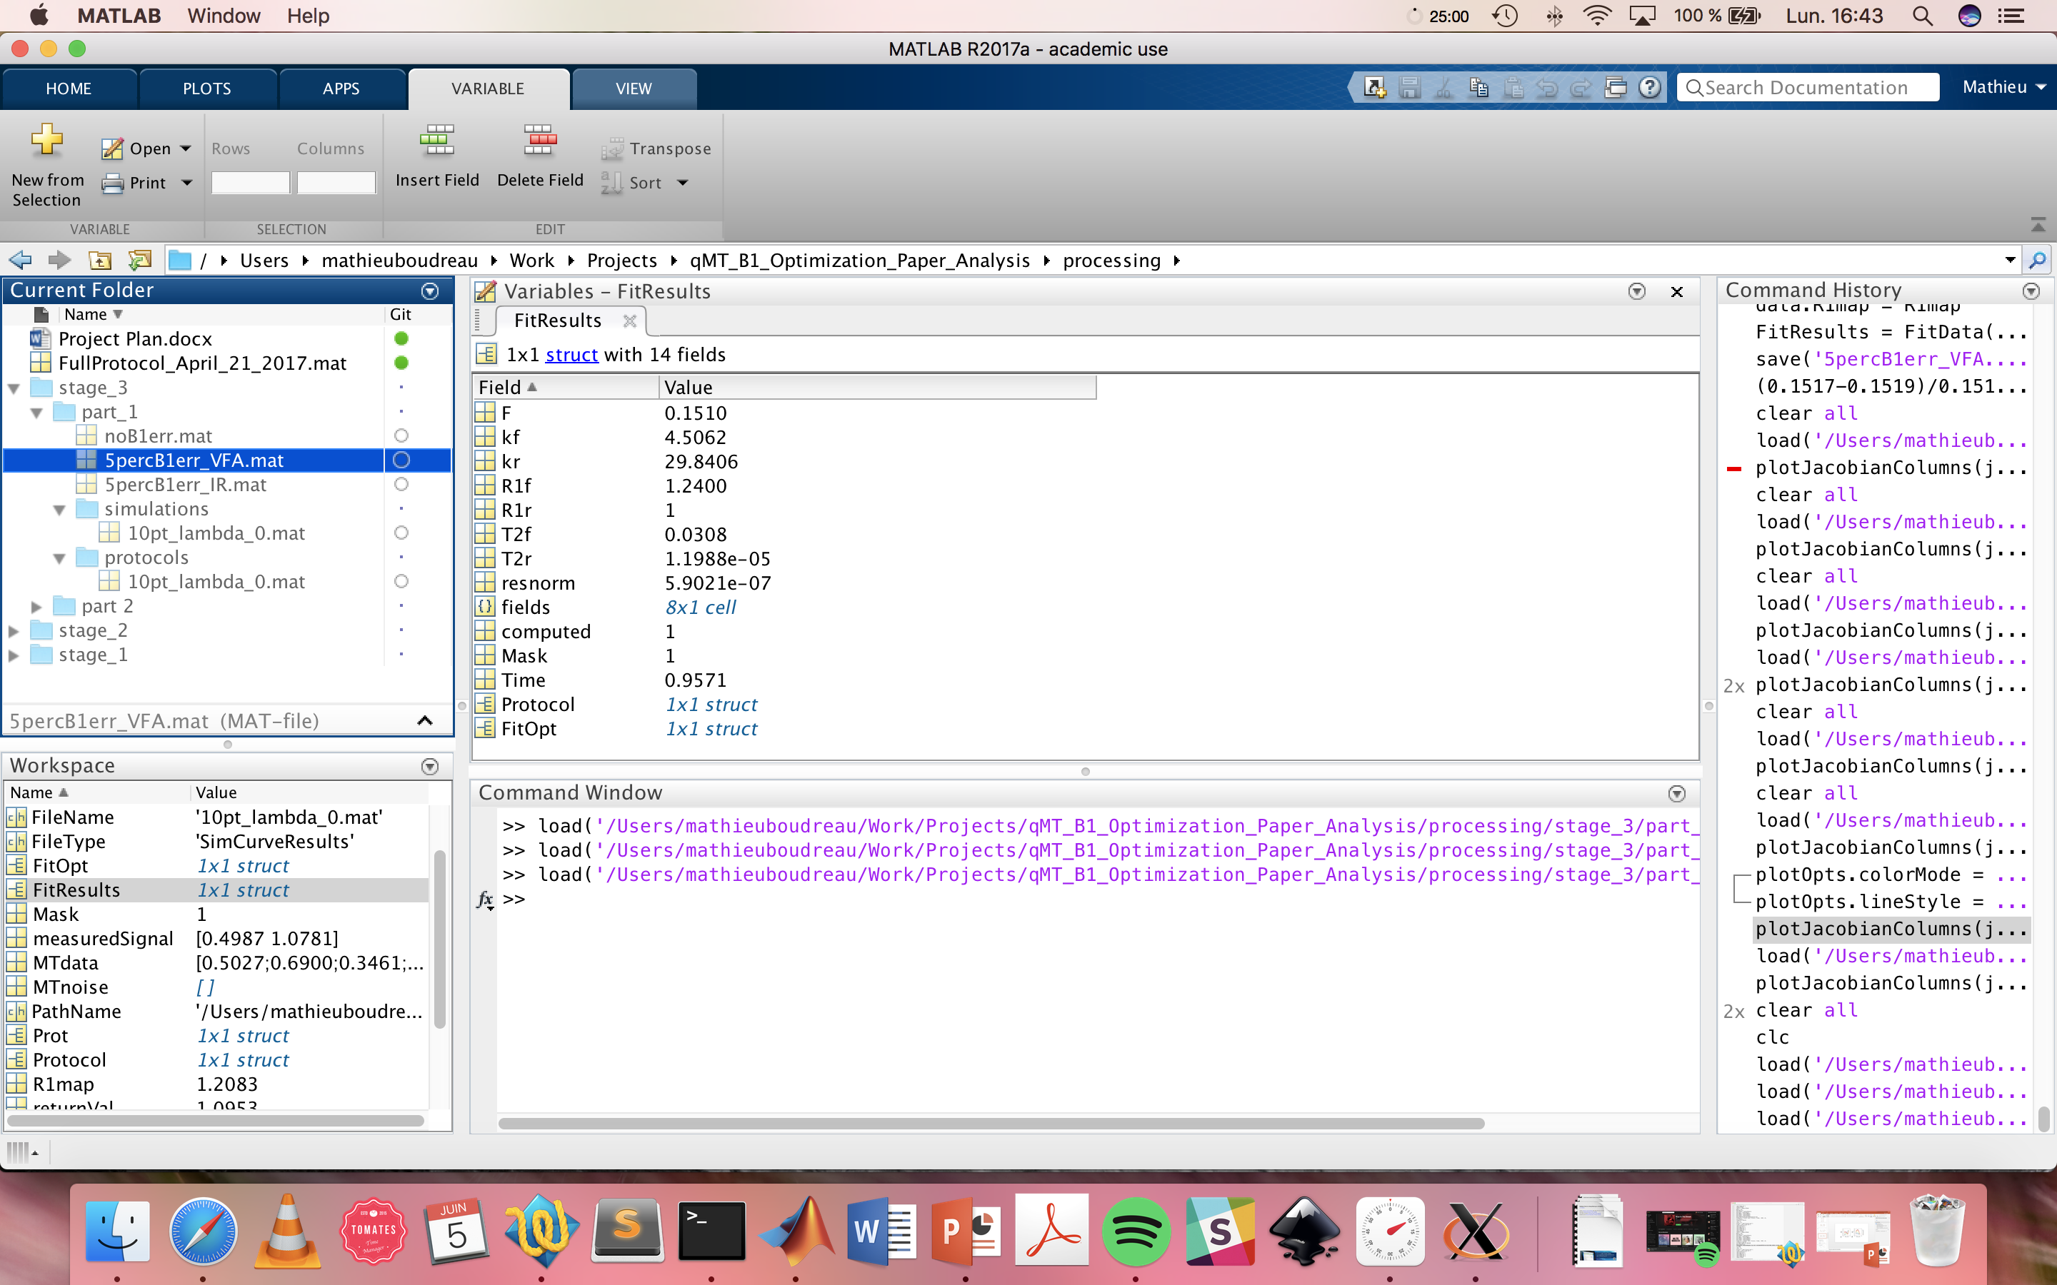
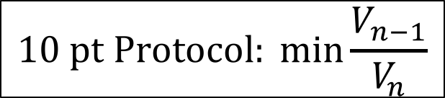
$$10 pt Protocol: min{\frac{V_{n−1}}{V_{n}}}$$
B1err = 0
B1err = 5%
IR T1
VFA T1
% error in F = 8.9%
% error in F = 0.49%

Slide 46
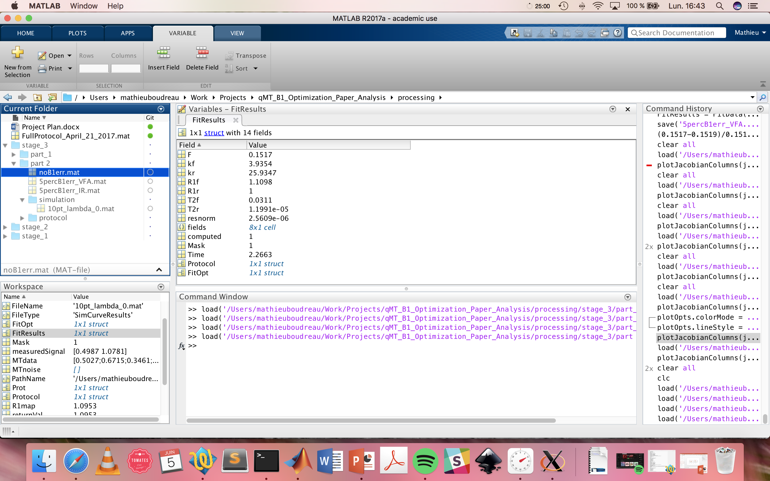
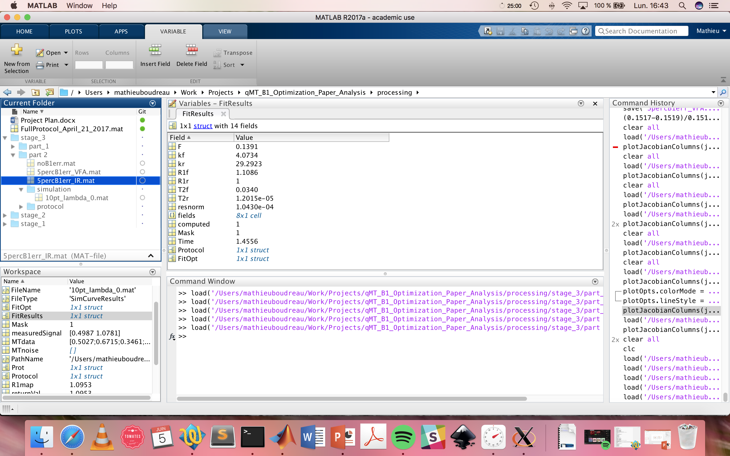
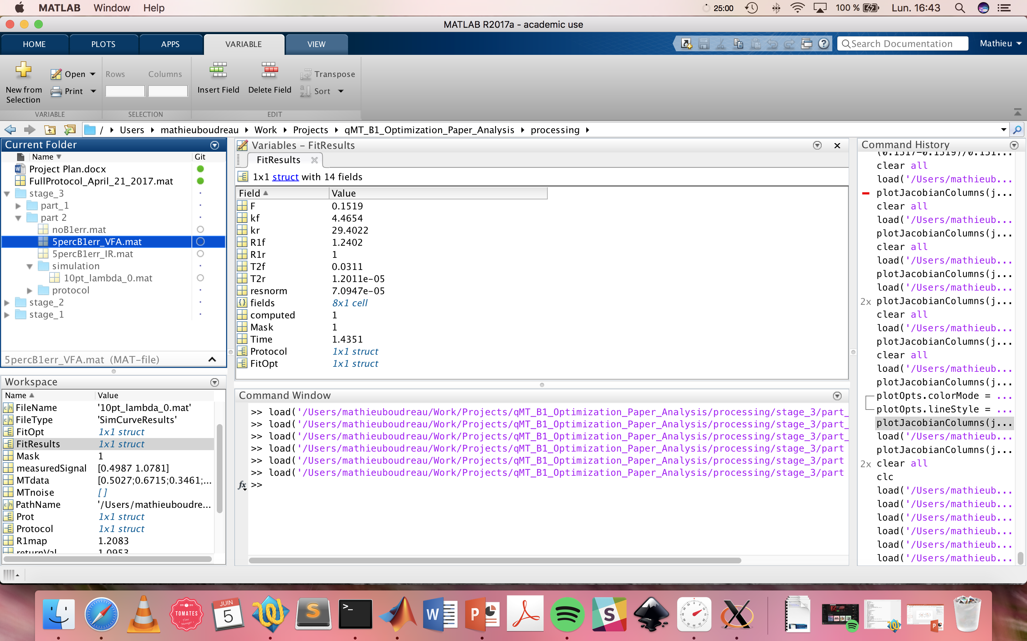
$10 pt Protocol: min{\frac{V_{n−1}}{V_{n}}}$ + $0.5{\left|ΔF\right|}_{n−1}, s.t. {ΔB}_{1}^{VFA}$ = 5%
B1err = 0
B1err = 5%
IR T1
VFA T1
% error in F = 8.4%
% error in F = 0.09%

Slide 47
To-Do (must)
WM Monte-carlo simulations
3 different 10 pt protocols
2FA with log-uniform offsets
CRLB optimized (lambda = 0)
CRLB regularized by B1 (lambda 0.5, deltaF_{B1}^{VFA})
Generate 10,000 signal sets for each protocol, with rician noise added
50, 100, 200 SNR for M0? More?
Fit Data
For delta B1 = 0, 1, 5, 10, 25 %?
Analysis? (means and std of fitted params, stat tests between methods?)
To-Do (optional?)
Repeat Monte Carlo for other fixed tissues (e.g. GM & lesions)?
Repeat Monte Carlo for gaussian-distributed tissue values?
Repeat Monte Carlo for voxels with partial voluming?
Repeat protocol optimization & Monte Carlo simulations for other qMT methods?
Ramani, Yarnikh
Evaluate optimization for different regularization criteria?
e.g. T1 & B0, or B1 for kf?

